Slide 1
35 days
Task 1
7/5 - 8/8
45 days
Task 2
7/30 - 9/12
47 days
Task 3
8/20 - 10/5
48 days
Task 4
8/29 - 10/15
40 days
Task 5
10/29 - 12/7
Milestone 2
Milestone 4
Aug 15
Feb 15
2015
Jun
Jul
Aug
Sep
Oct
Nov
Dec
2016
Feb
2016
Today
Jun 18
Milestone 3
Nov 10
Feb 28
Milestone 1
Milestone 5

Slide 2
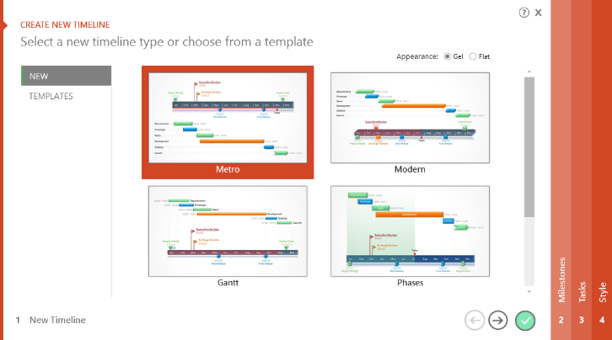

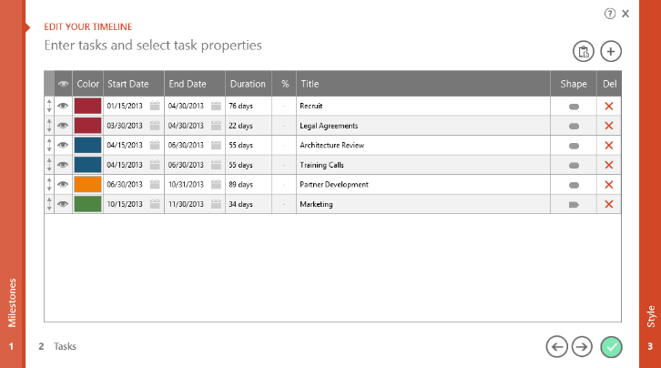
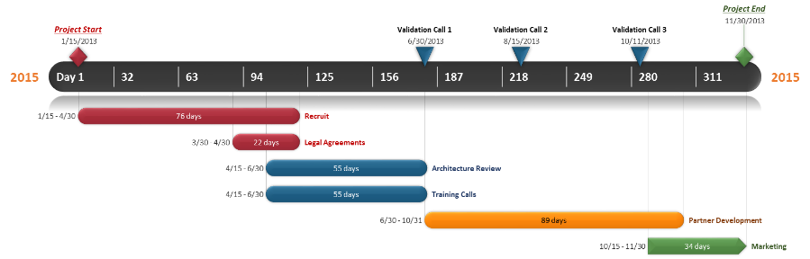
To change and update this template automatically,
download the free Office Timeline PowerPoint add-in!
Office Timeline is a free, award winning, timeline maker that's really easy to use.
Simple, easy-to-use wizards.
Professional, quick results.
Built directly into PowerPoint

